Slide 1



Bank Customer Churn Prediction
1

Slide 2
Team Members:
Instructor:
Ayman Sayed
Menna Hassanin
Saleh Ali
Amgad Sabry
Mohamed Ali
Marawan Ahmed

Slide 3
Table of Contents
Introduction
Importing libraries
Loading Data
Exploratory Data Analysis (EDA)
Feature Engineering
Data Preprocessing
Classification Modelling
Model Deployment
Conclusion

Slide 4
Introduction
The bank customer churn dataset serves as a valuable resource for analyzing customer retention in the banking industry. It contains detailed information about customers, including unique identifiers, demographics such as age and gender, financial metrics like credit score and account balance, and engagement indicators like tenure and product usage. The dataset categorizes customers based on their status (whether they have remained with the bank or exited) making it ideal for predictive modeling and understanding the factors influencing customer churn. By leveraging this data, businesses can enhance customer retention strategies and improve overall service quality.

Slide 5
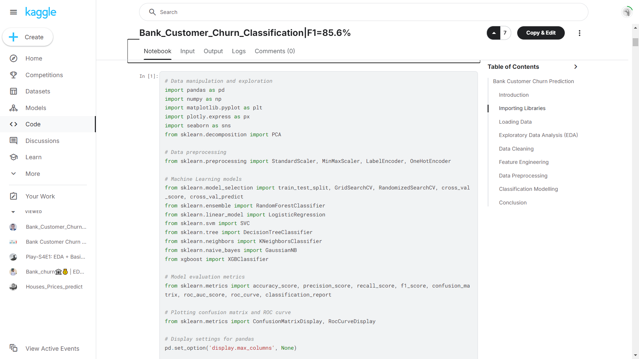
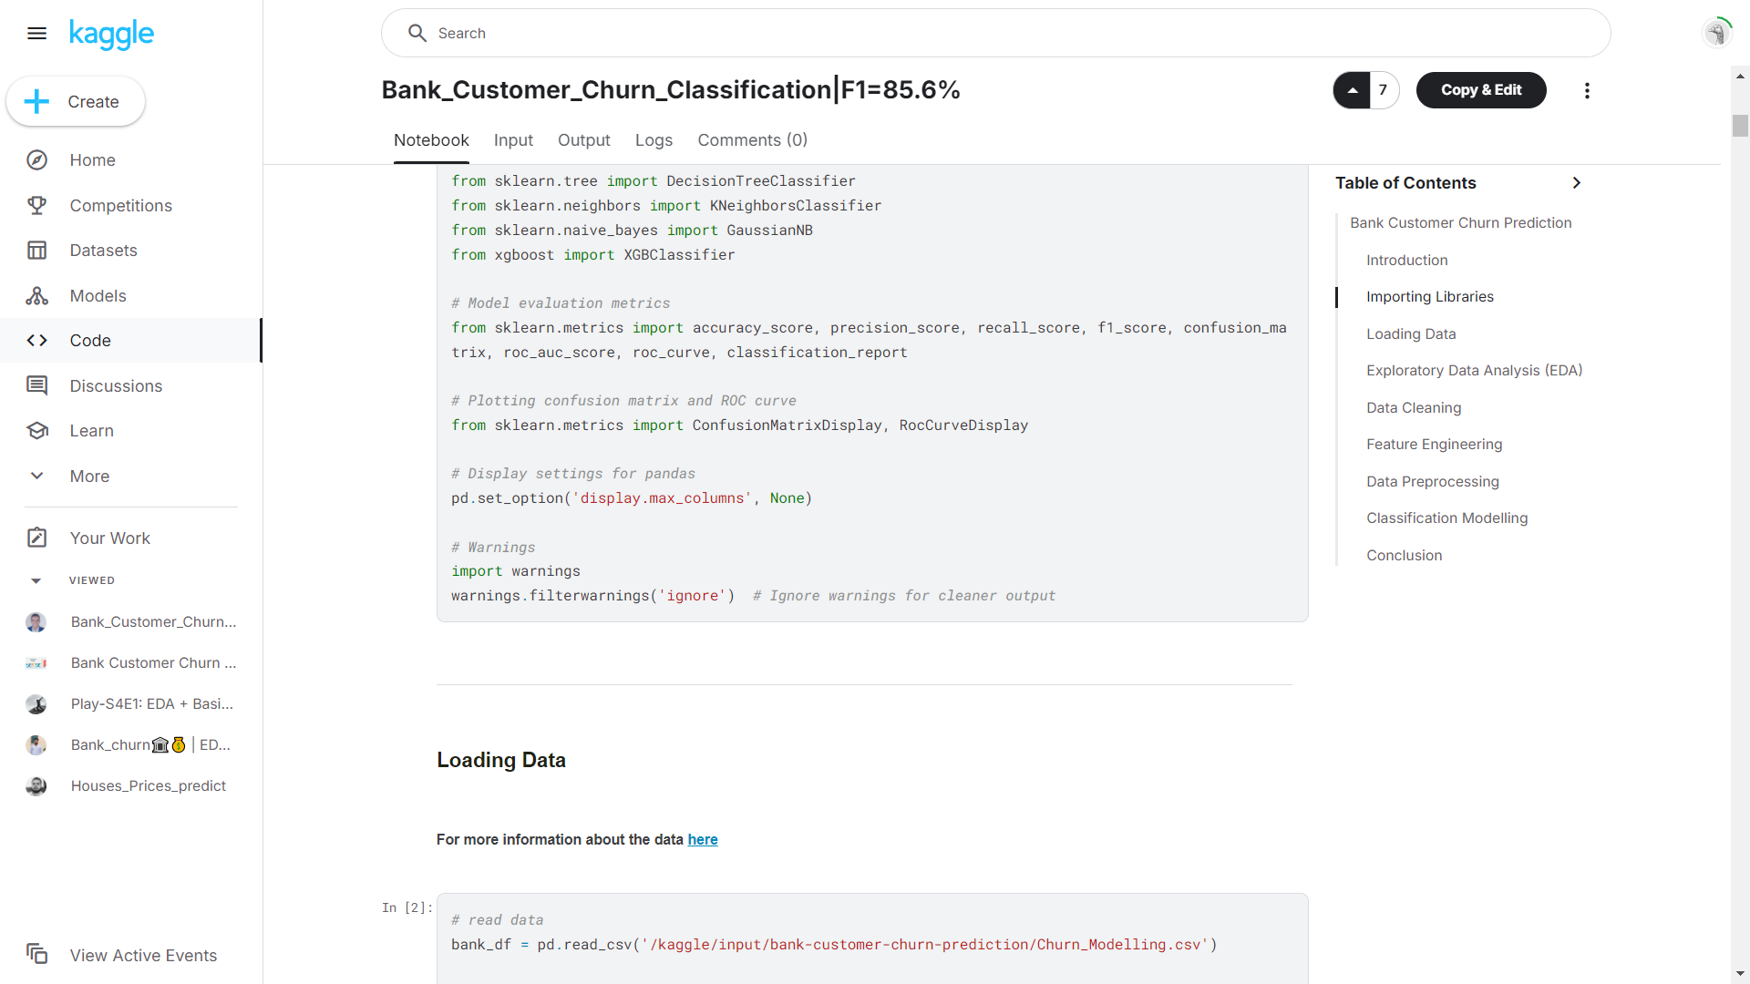
Importing libraries

Slide 6
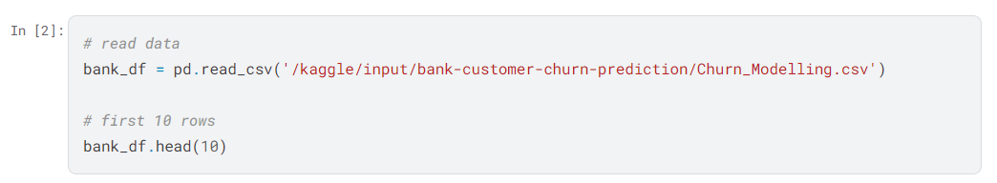
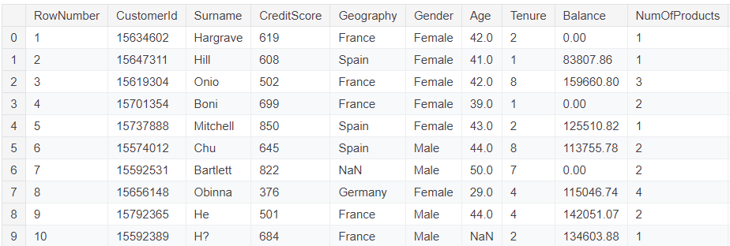
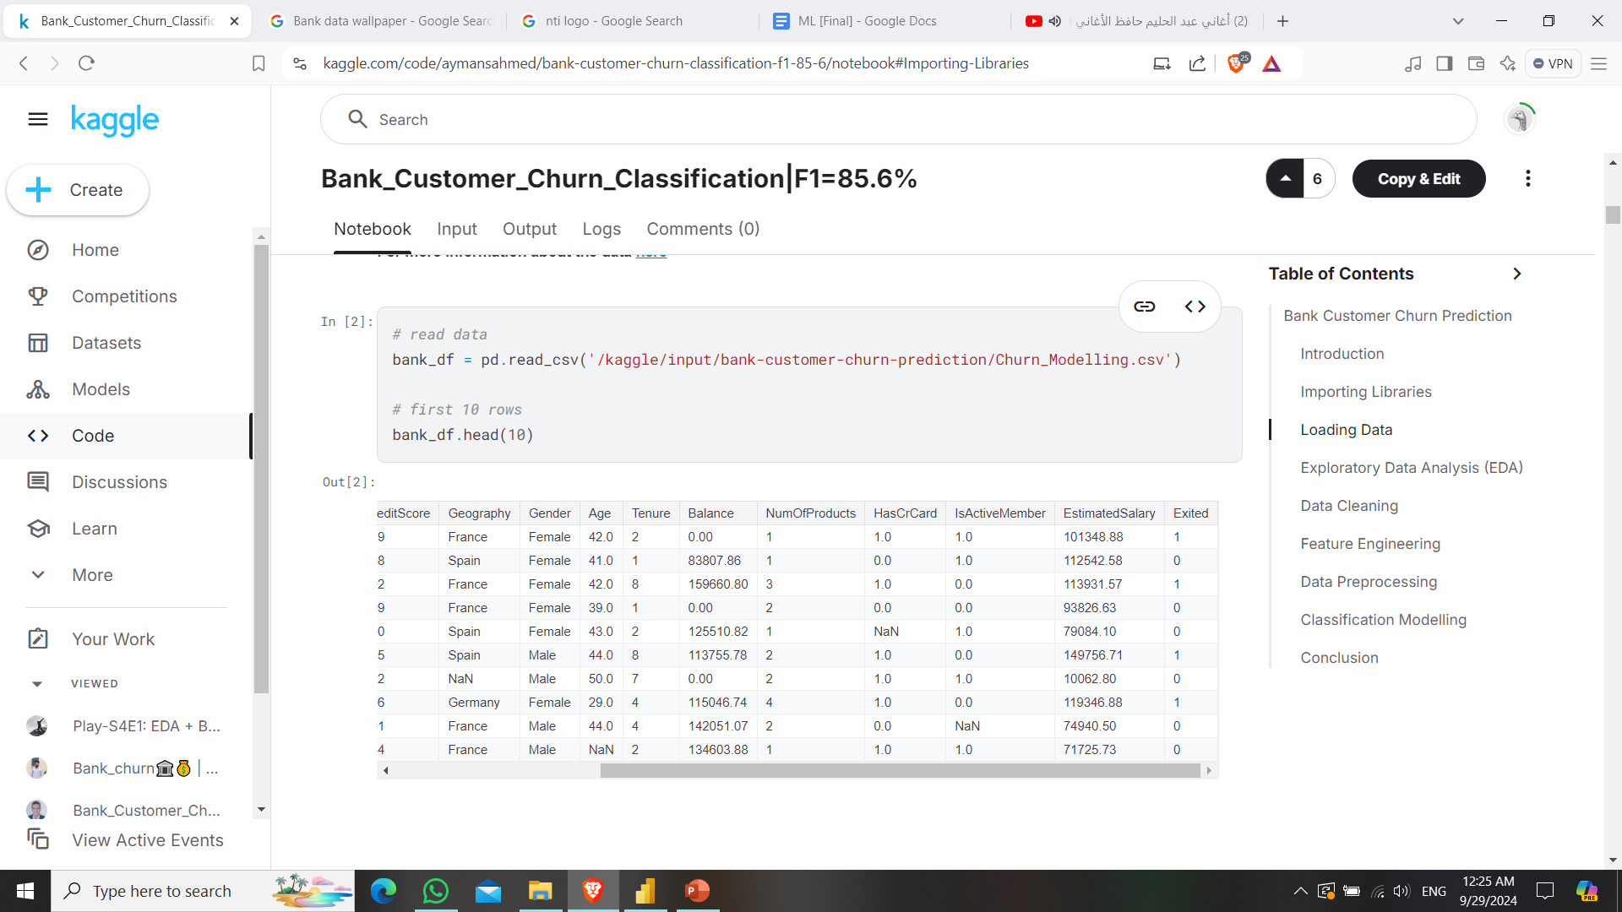
Loading Data

Slide 7
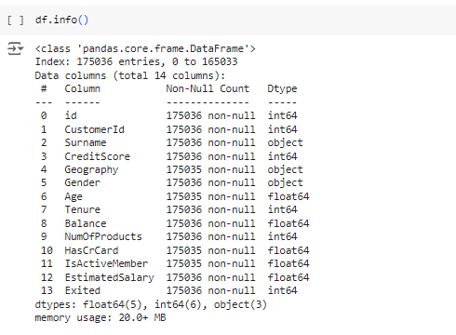
Exploratory Data Analysis (EDA)

Slide 8
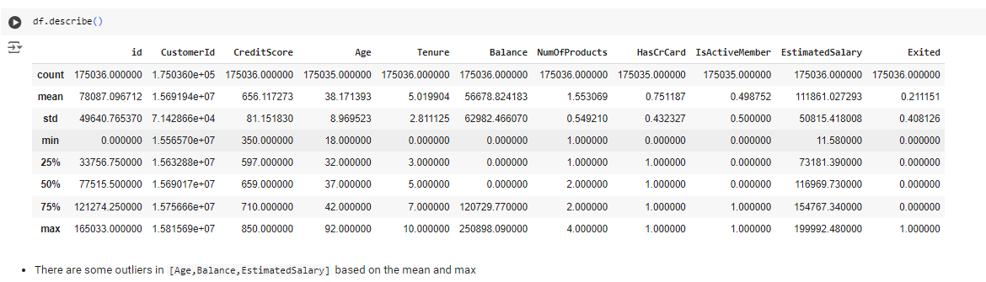
Exploratory Data Analysis (EDA)

Slide 9
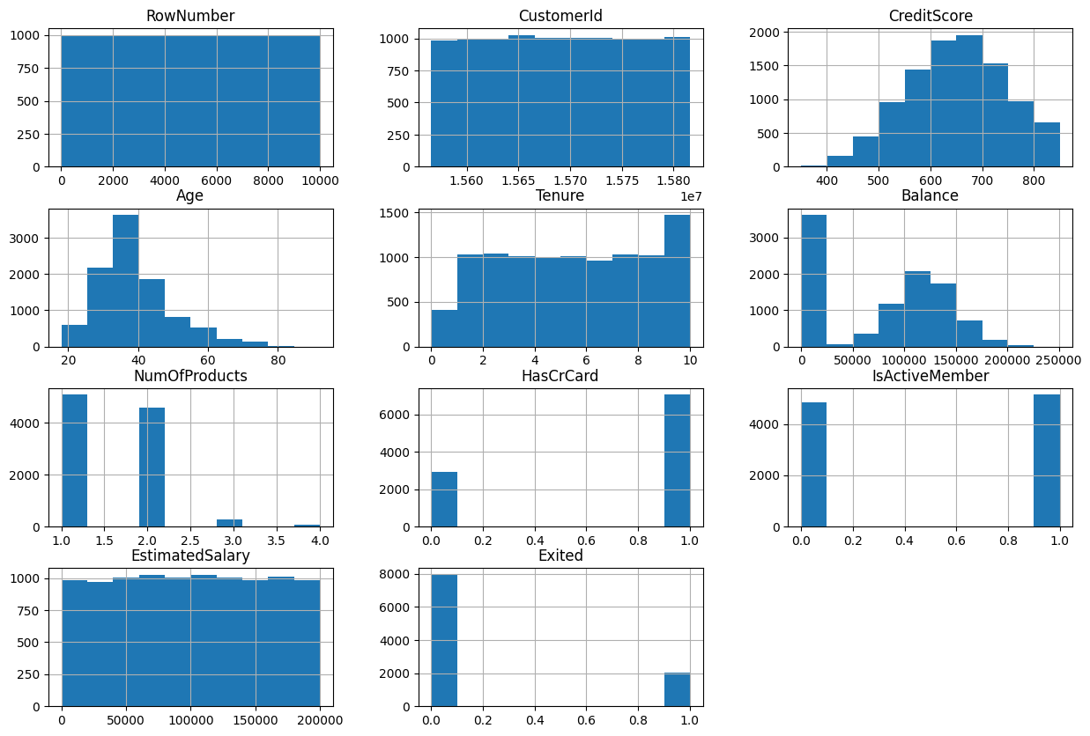
Exploratory Data Analysis (EDA) : Data Visualization

Slide 10
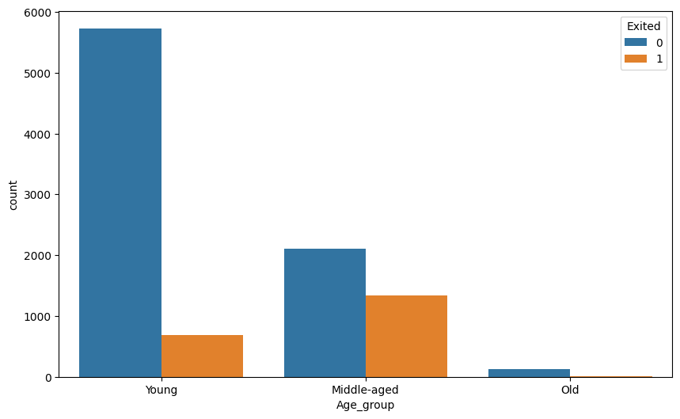
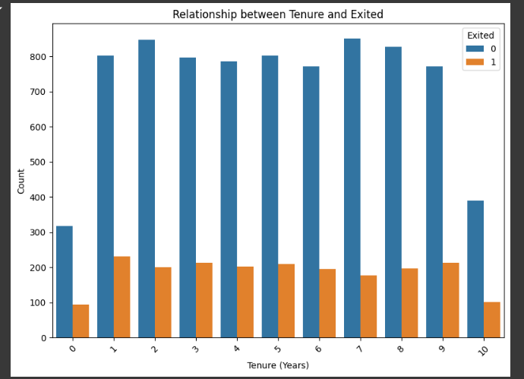
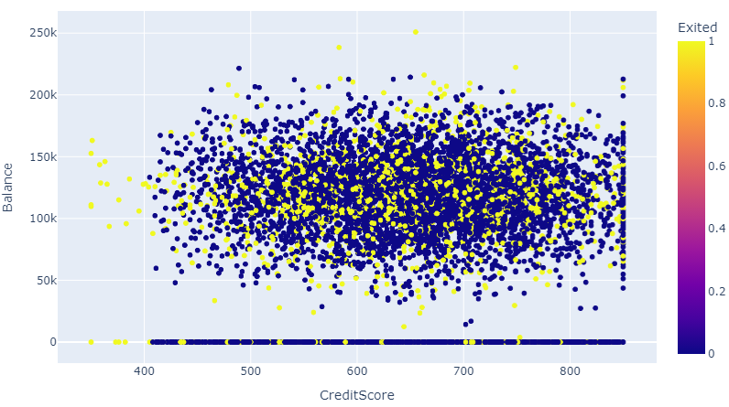
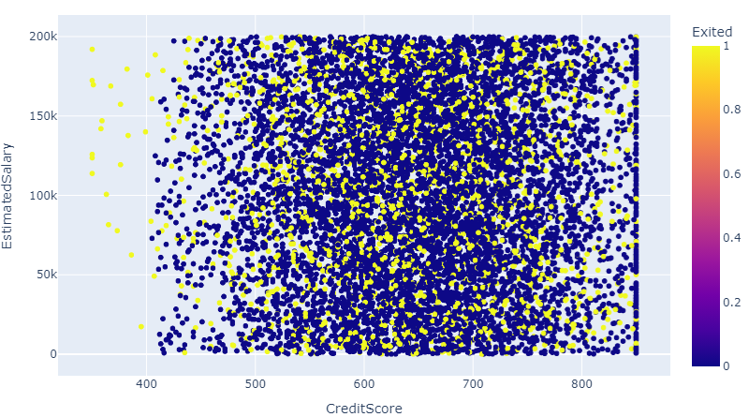
Exploratory Data Analysis (EDA) : Data Visualization

Slide 11
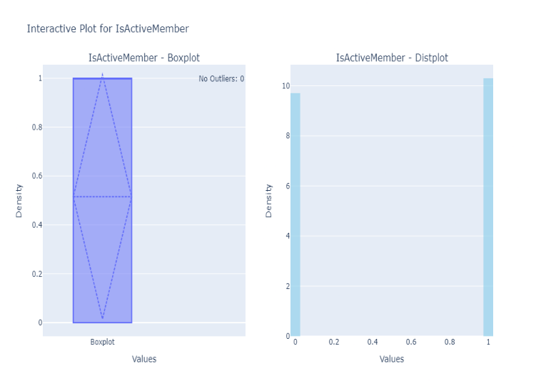
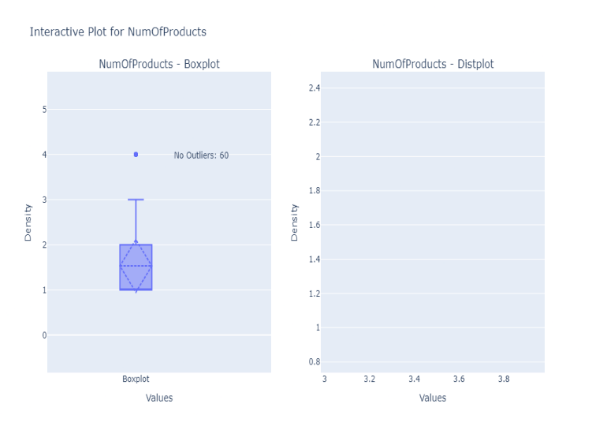
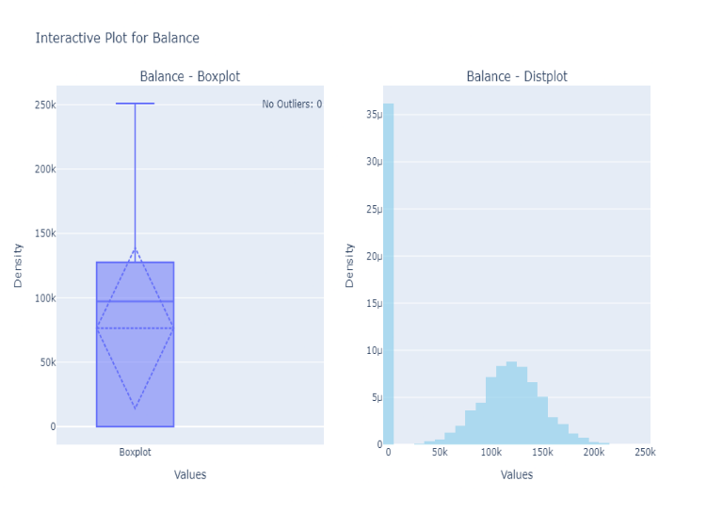
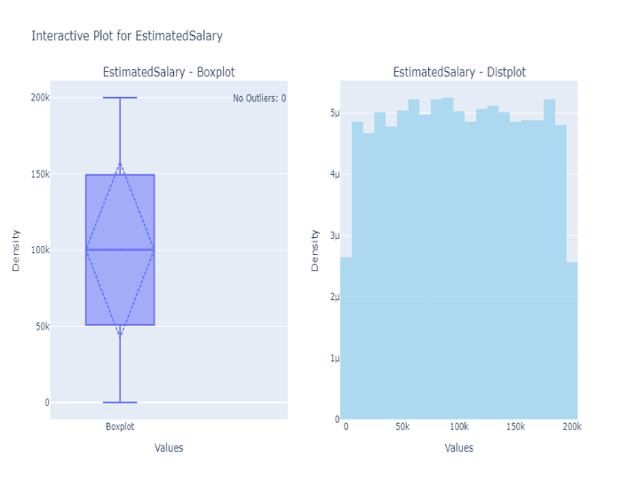
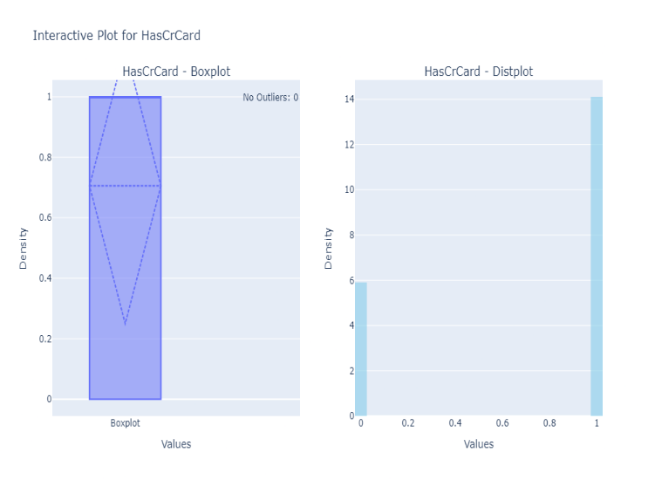
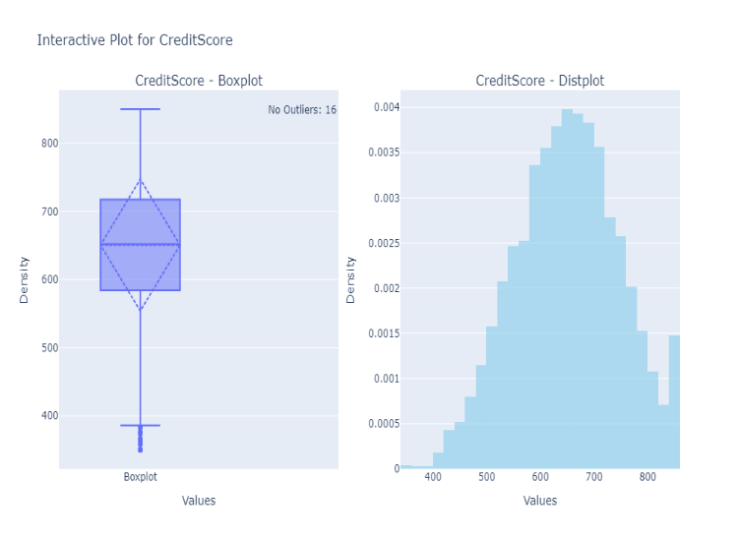
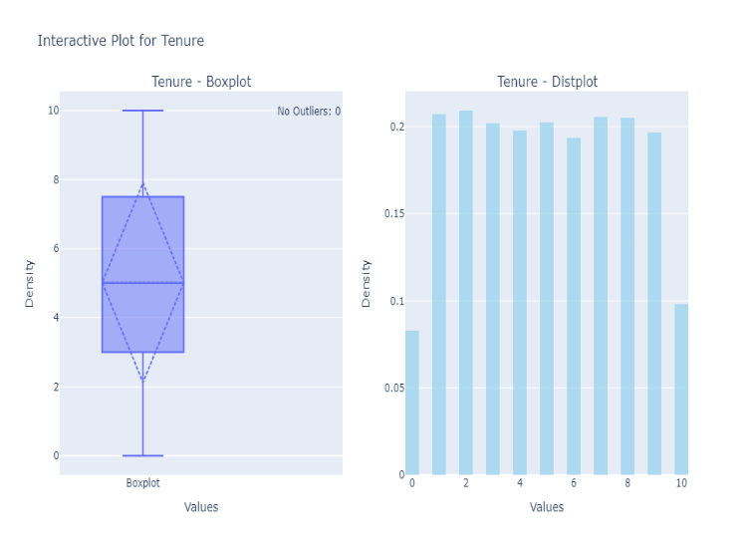
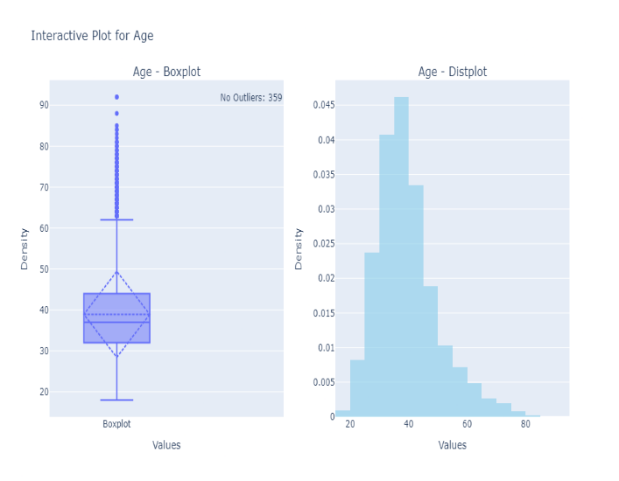
Exploratory Data Analysis (EDA) : Outliers

Slide 12
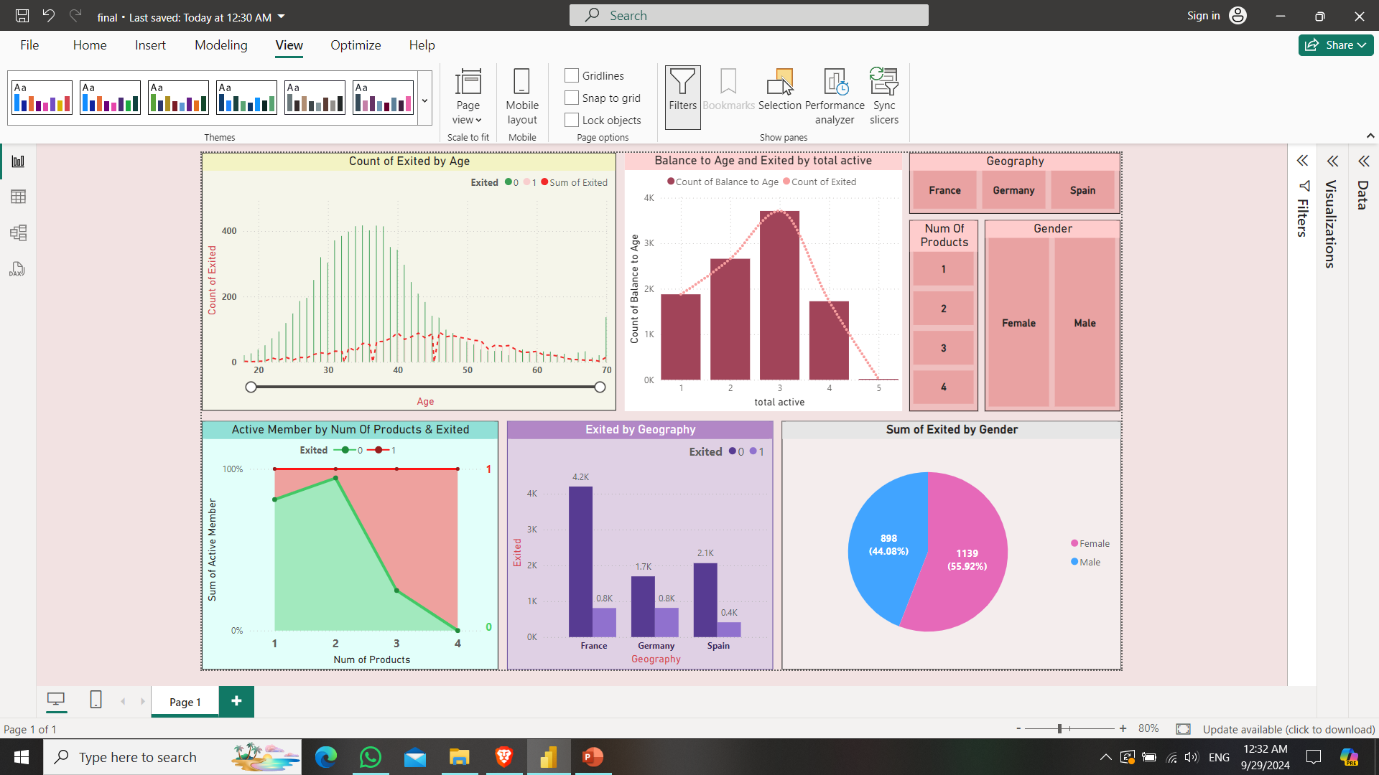
Dashboard [ Power Bi ]

Slide 13
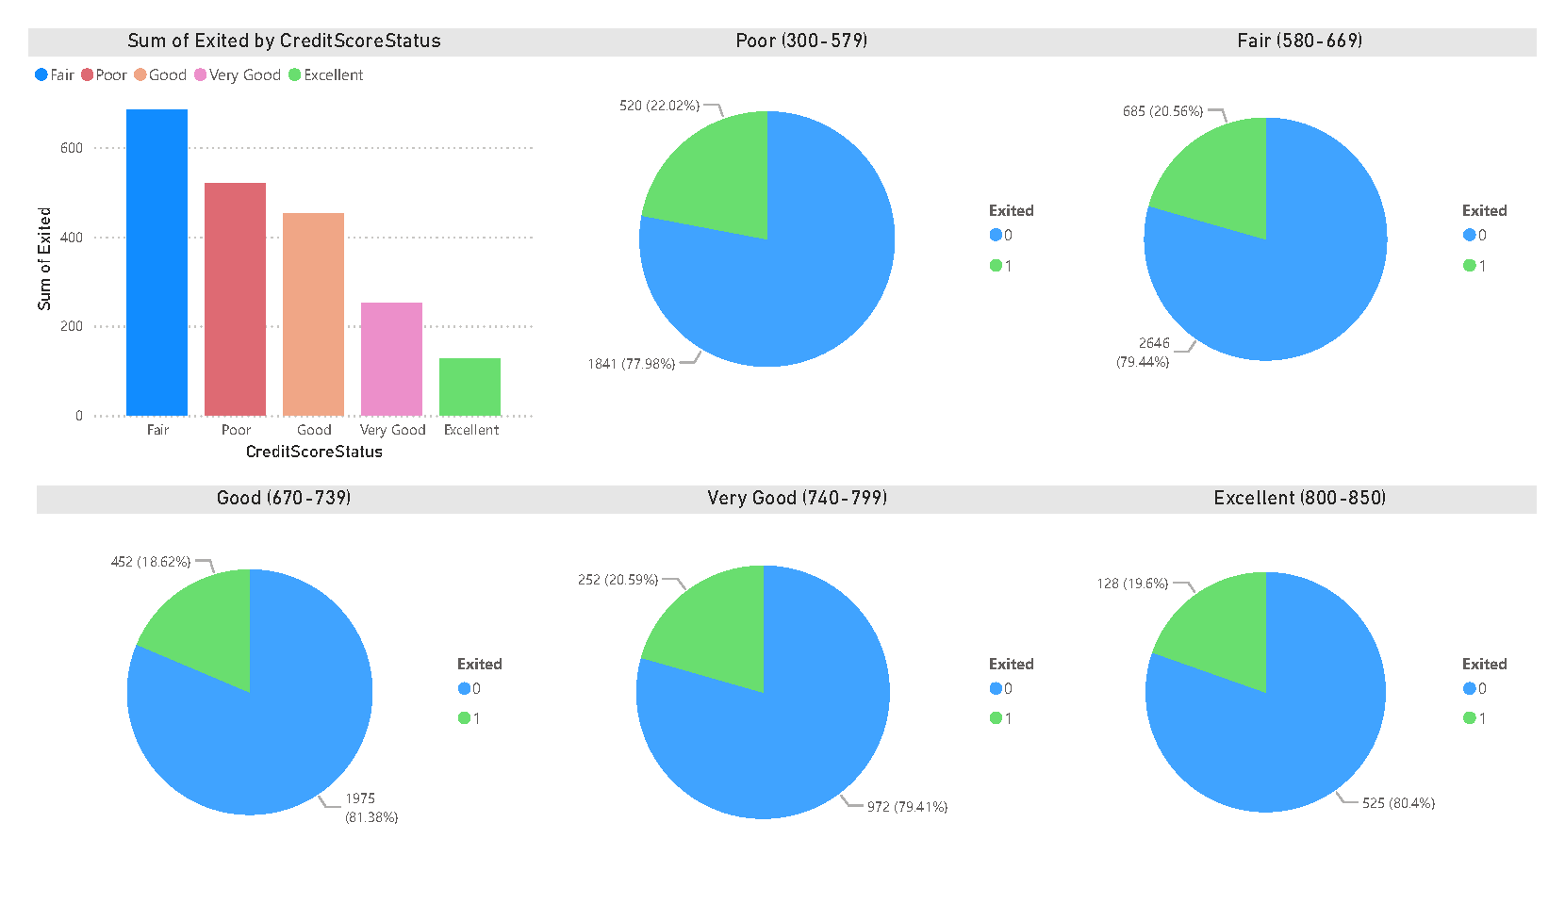
Dashboard [ Power Bi ]

Slide 14
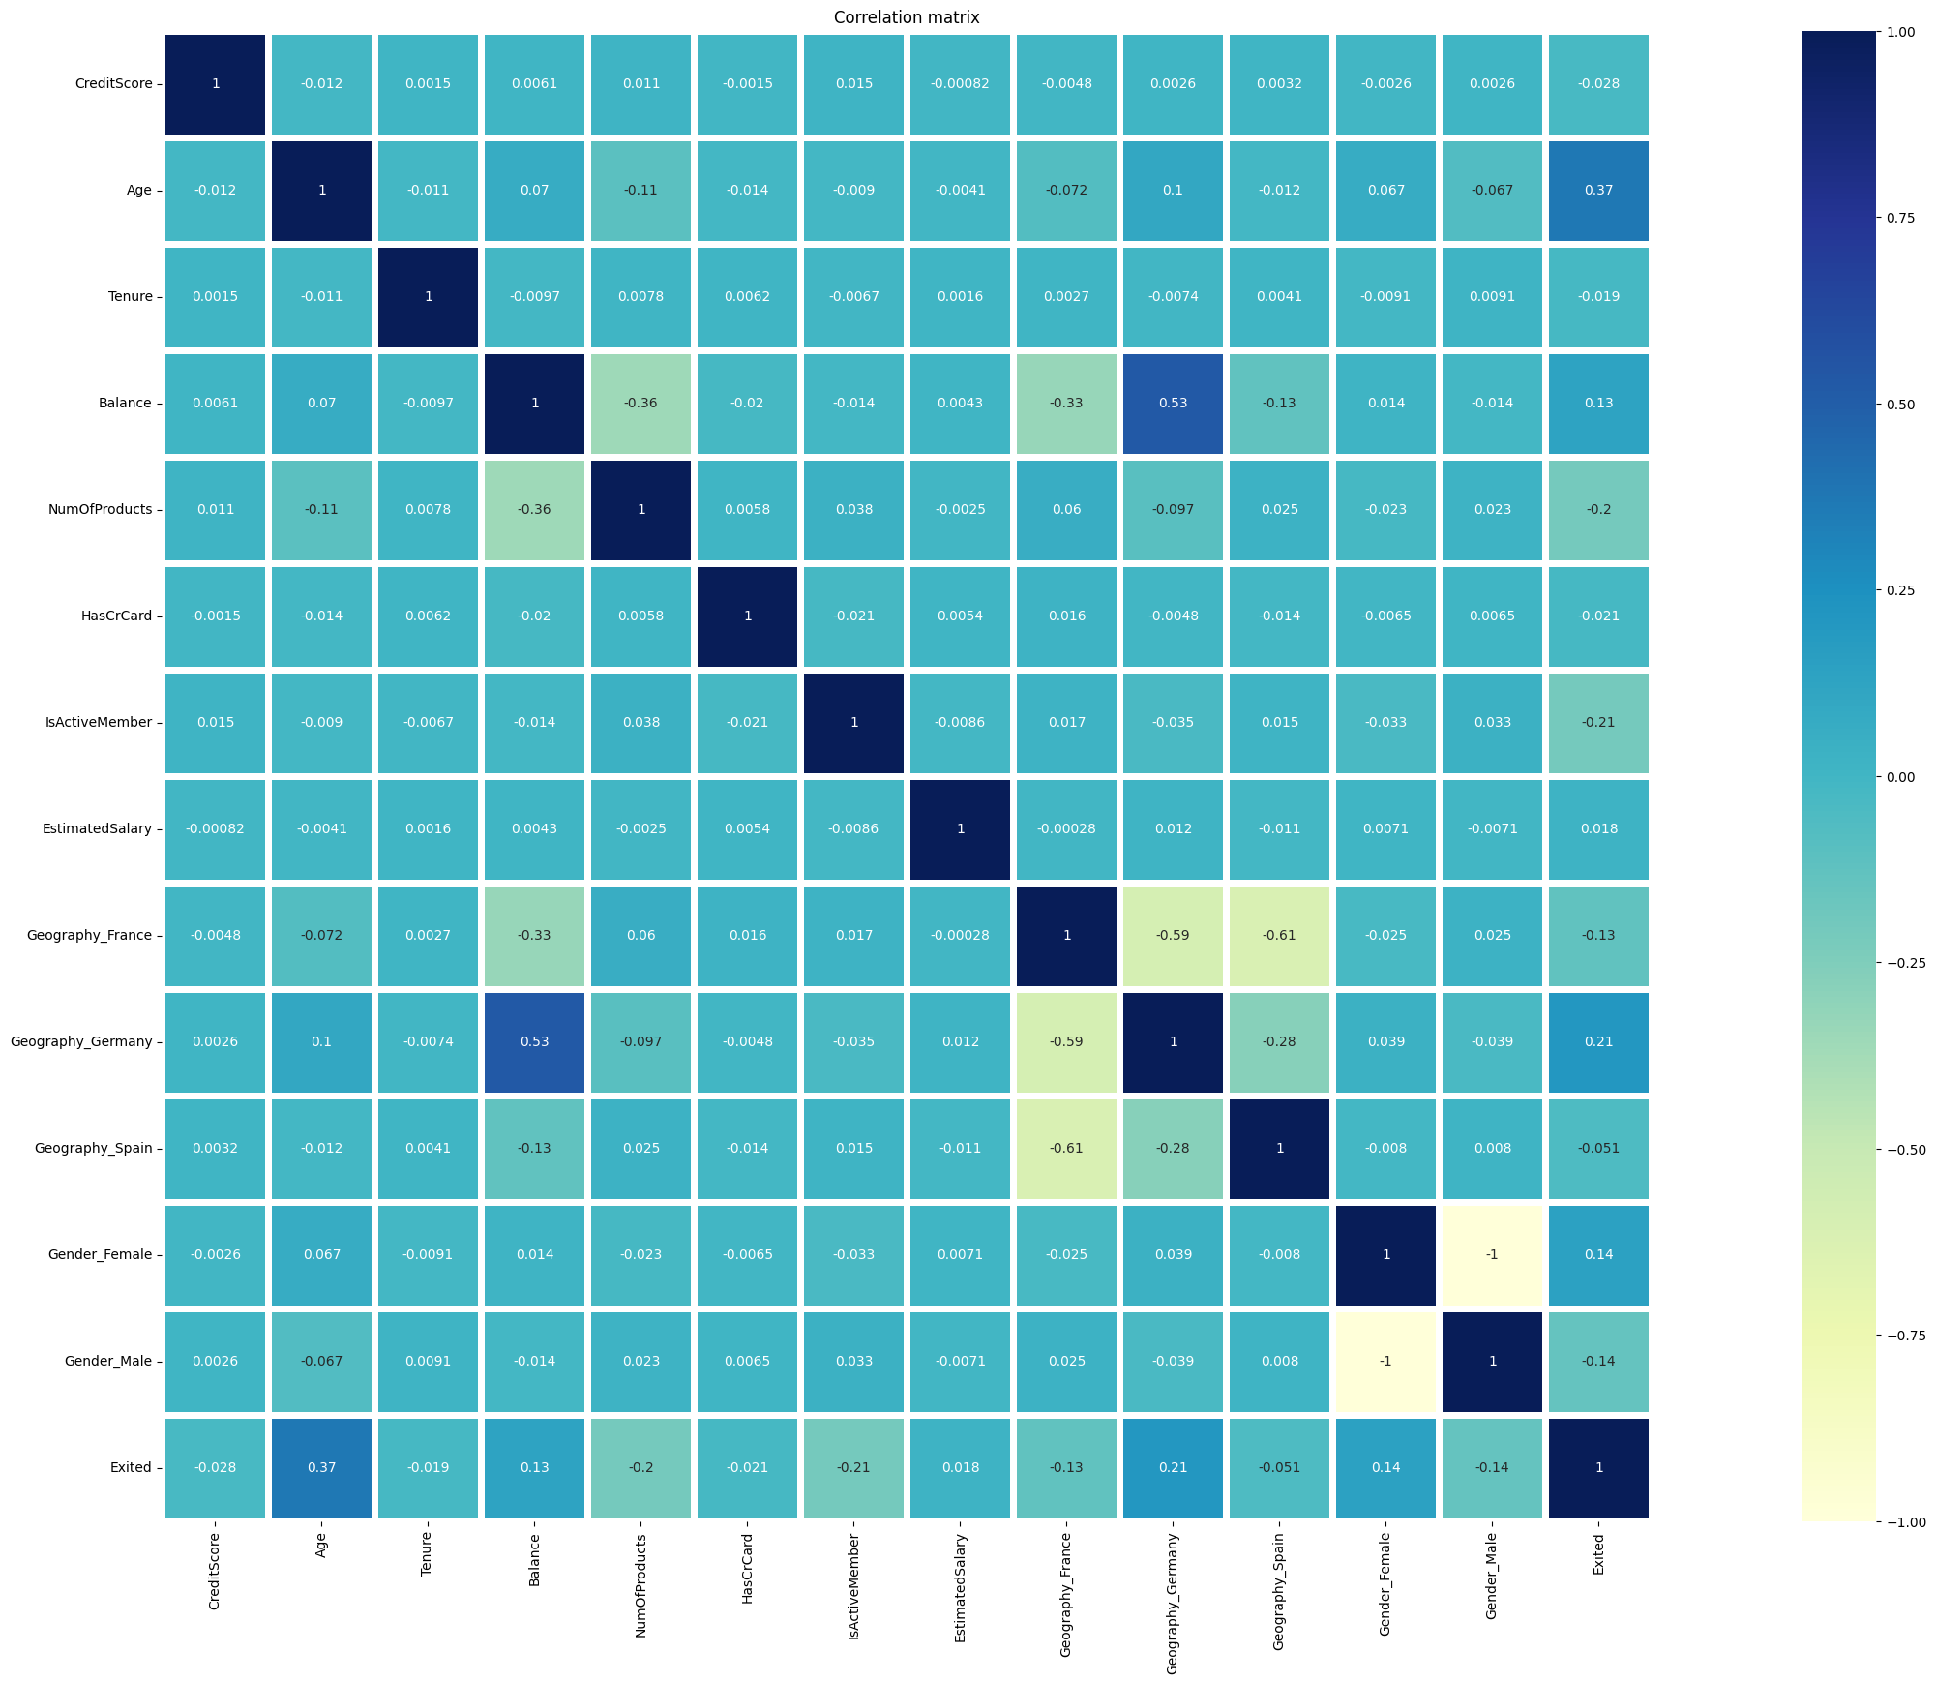
Feature Engineering: Data Correlation

Slide 15
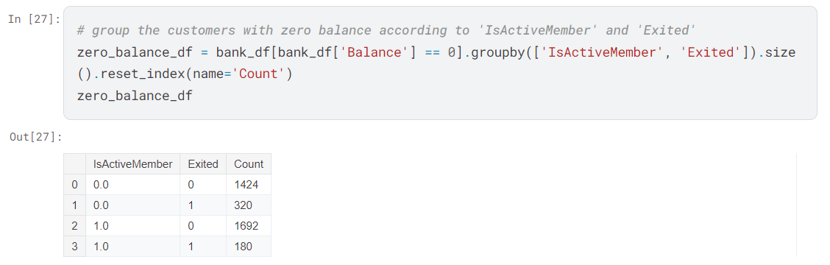

Feature Engineering Approach (1): Grouping Zero Balance Customers
This shows a conflict. How a member to Exit and still being an active member (180 member).
So, we will change these members to be inactive

Slide 16
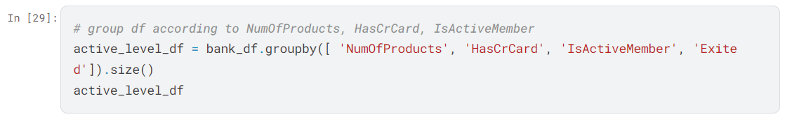
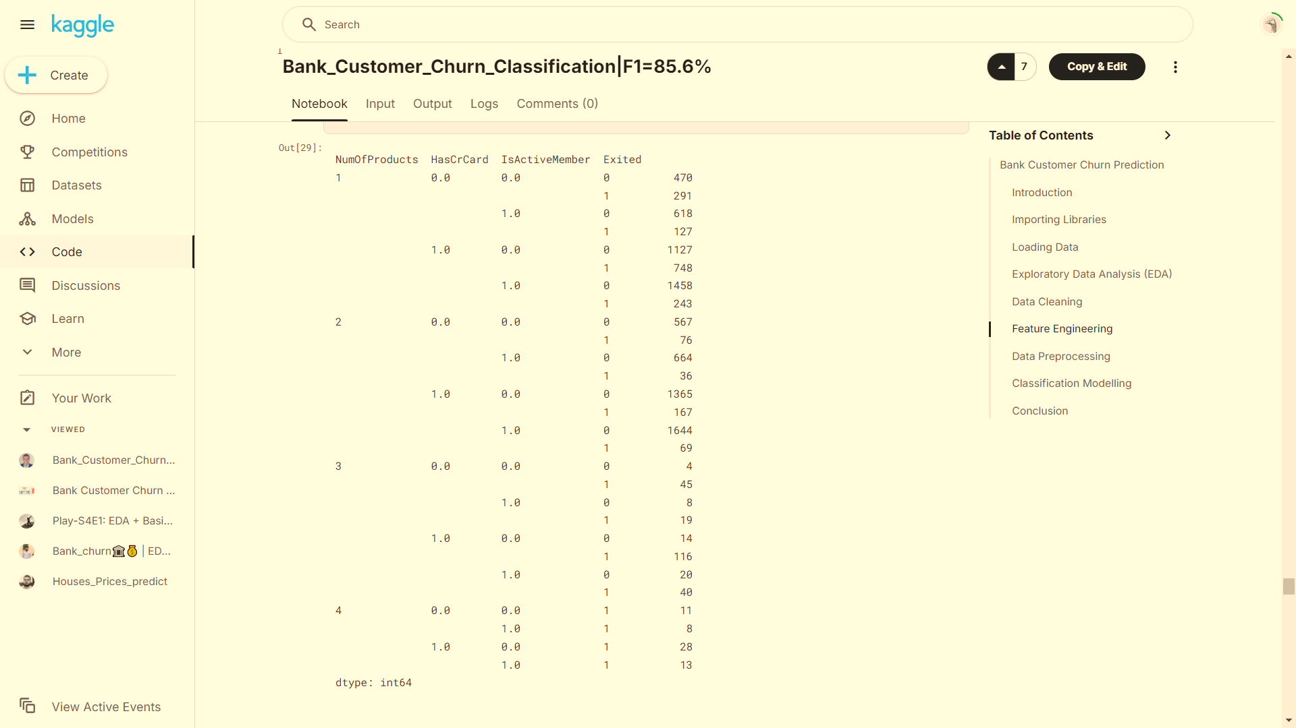
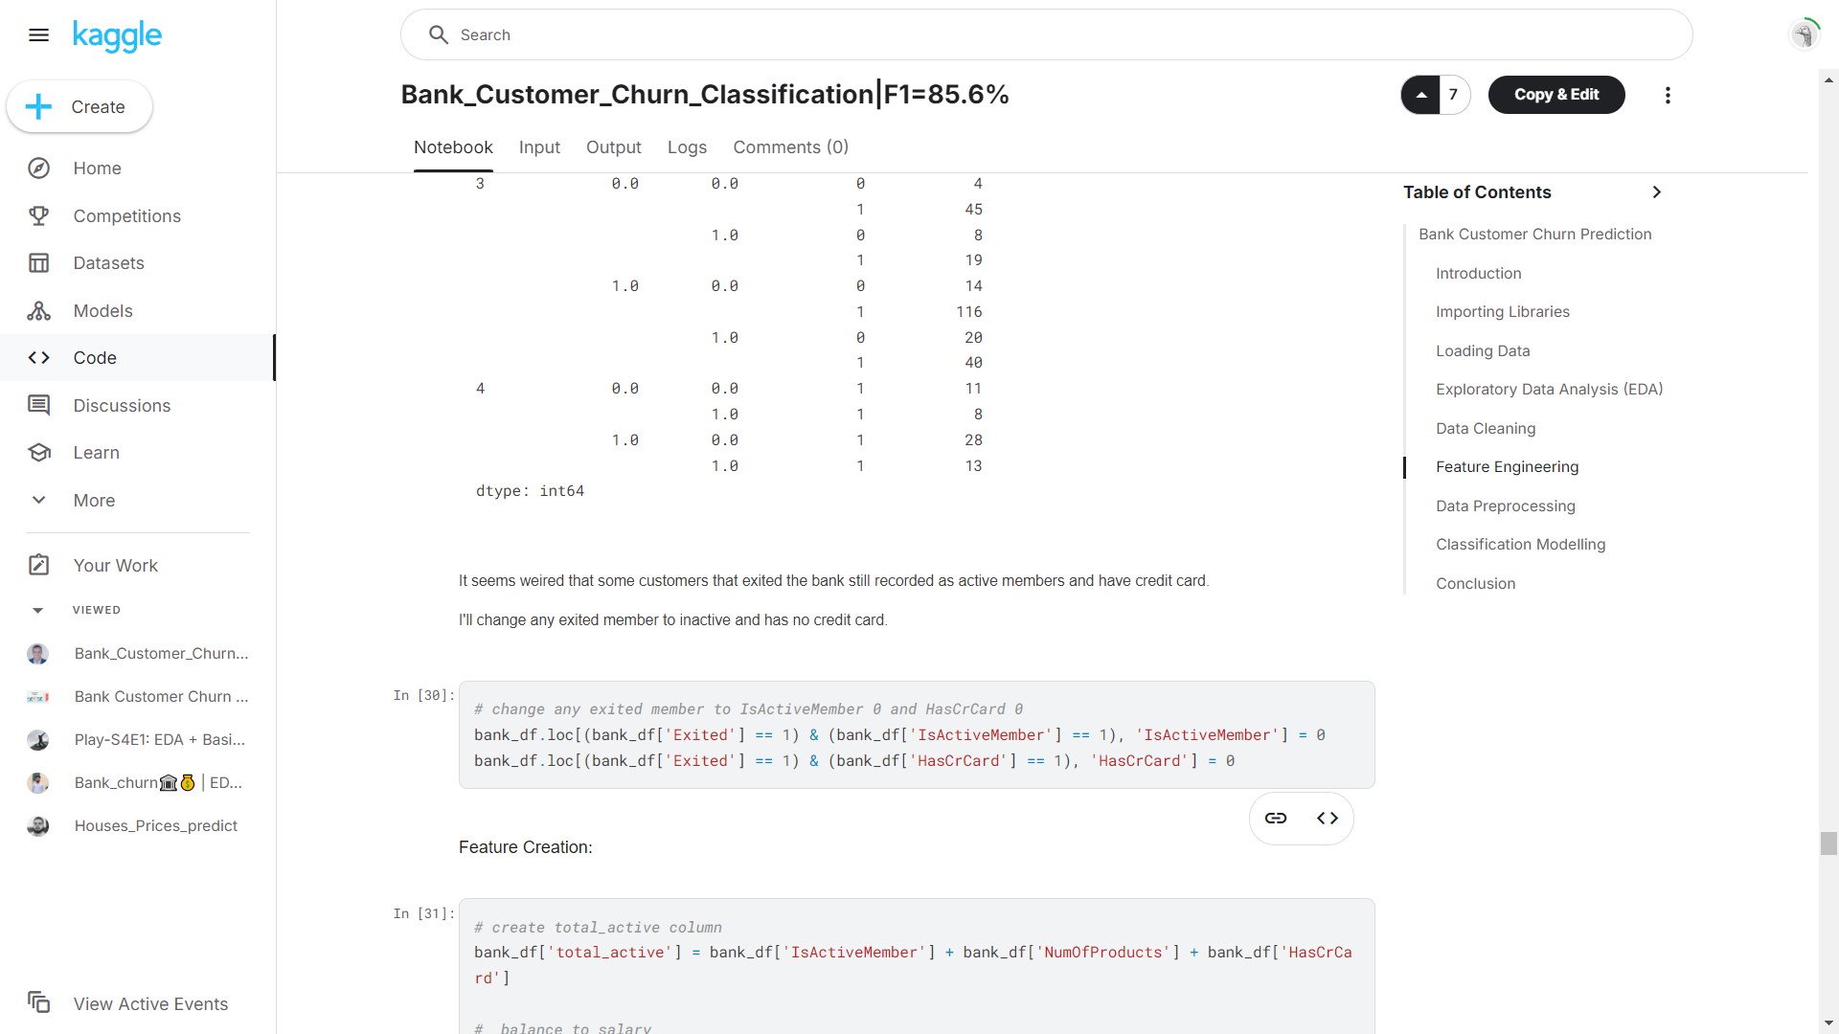
Feature Engineering : Active Level Grouping
It seems weird that some customers who exited the bank are still recorded as active members and have credit cards.
So we will change any exited member to inactive and has no credit card.

Slide 17
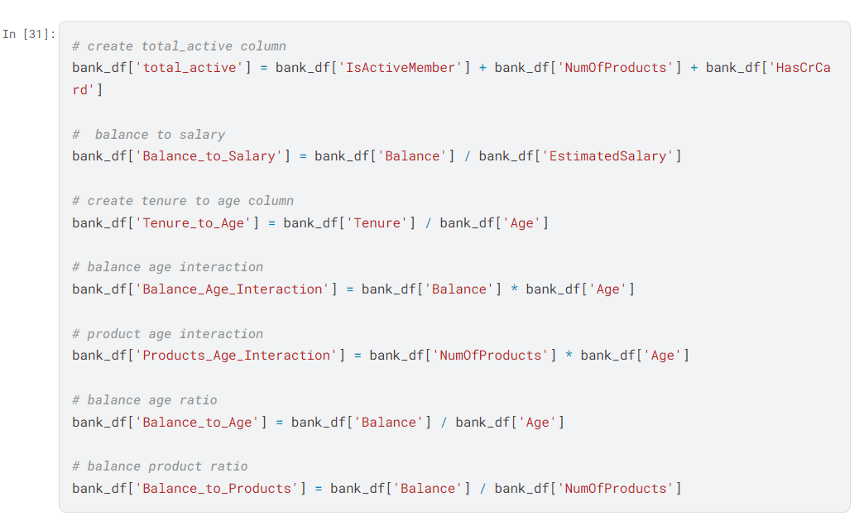
Feature Engineering : Feature Creation

Slide 18
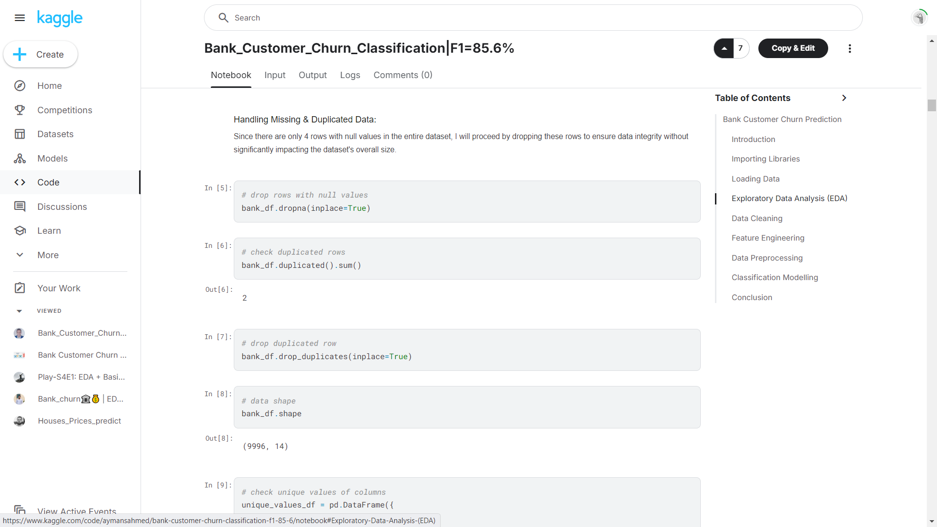
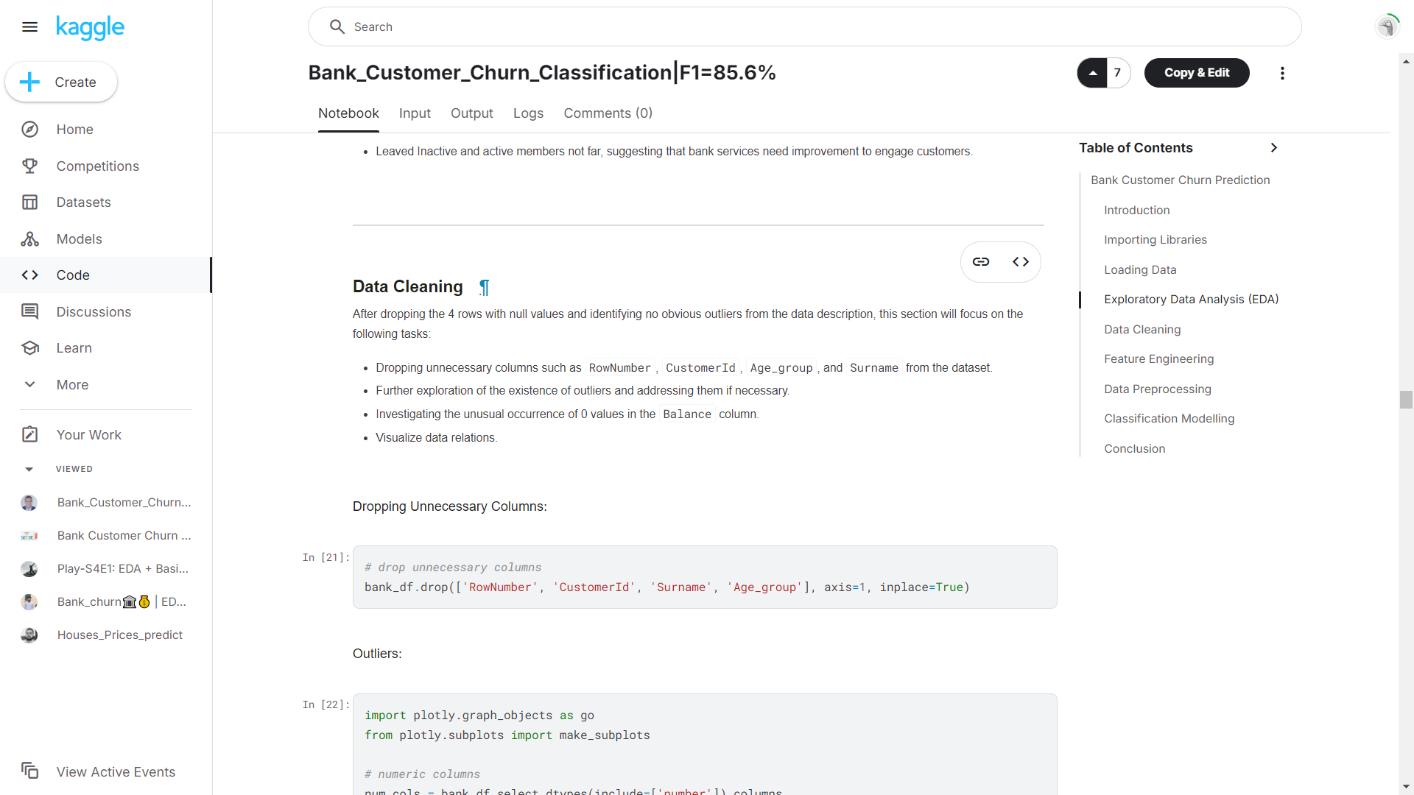
Data Preprocessing : Approach (1)

Slide 19
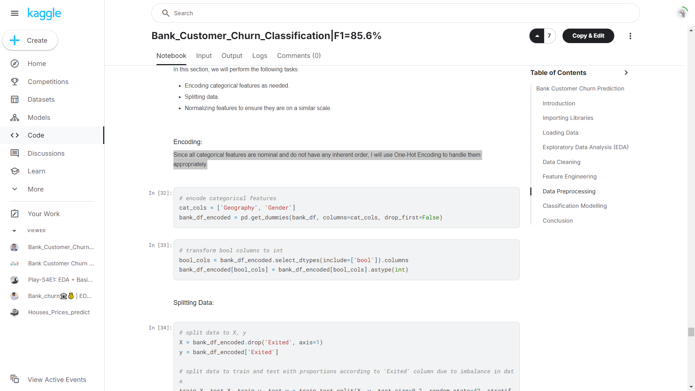
Data Preprocessing : Encoding categorical features
Since all categorical features are nominal and do not have any inherent order,
We will use One-Hot Encoding to handle them appropriately.

Slide 20
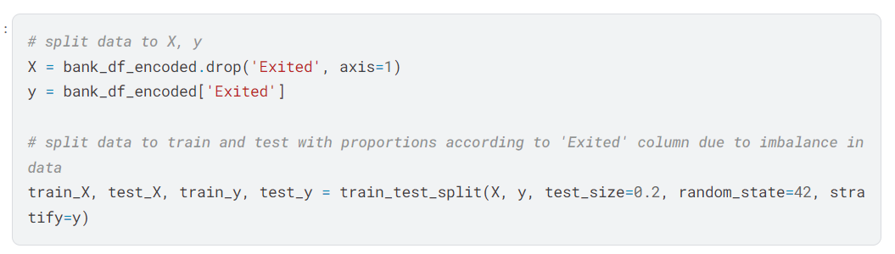
Data Preprocessing : Splitting Data

Slide 21
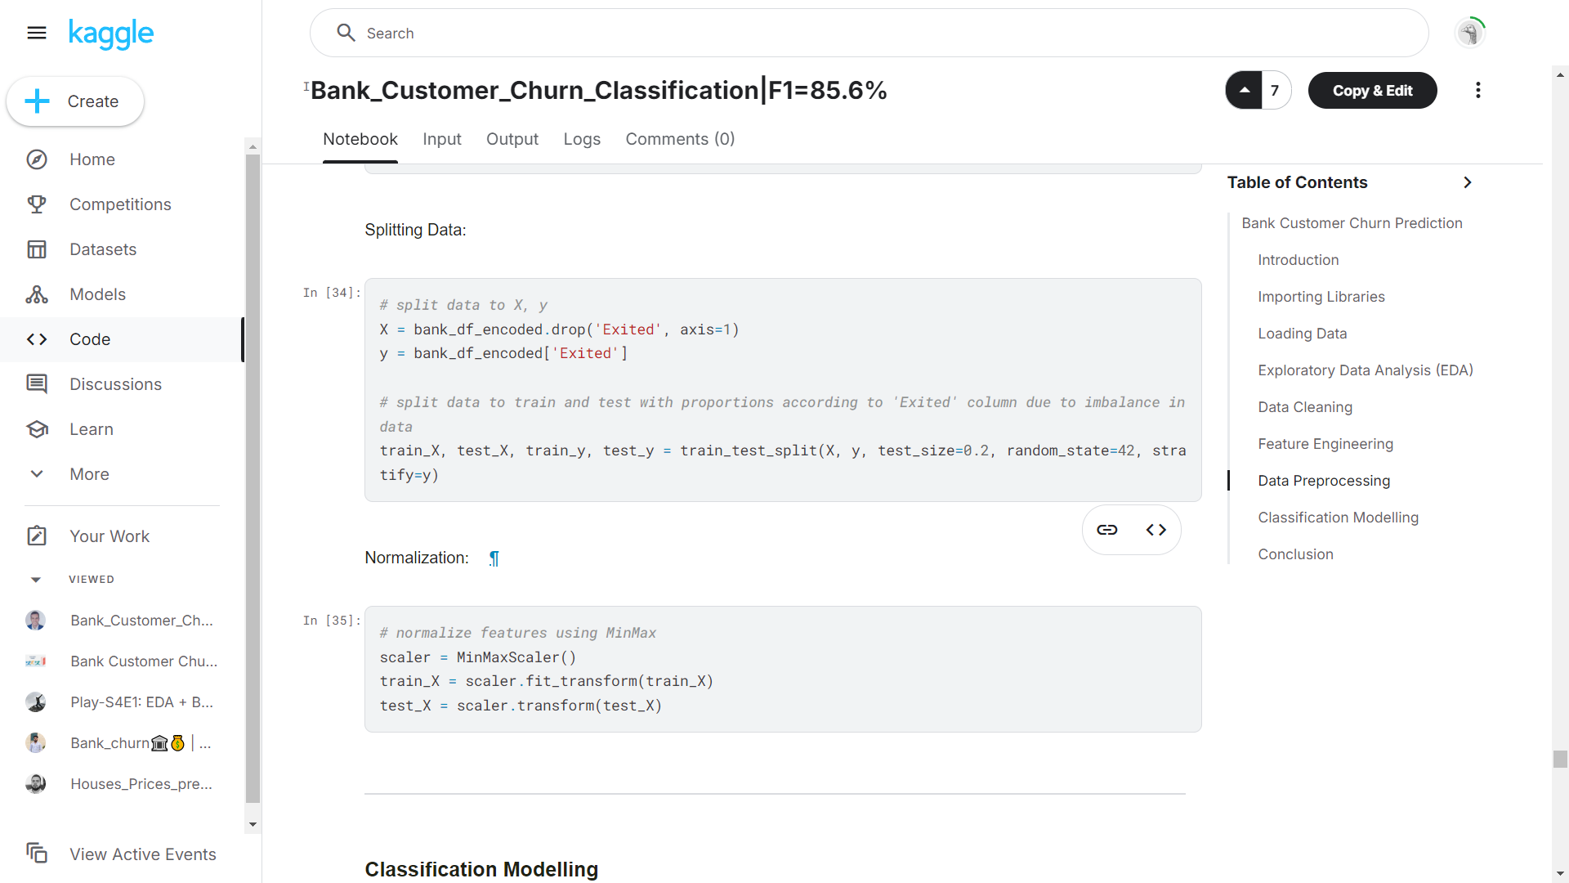
Data Preprocessing : Normalization

Slide 22
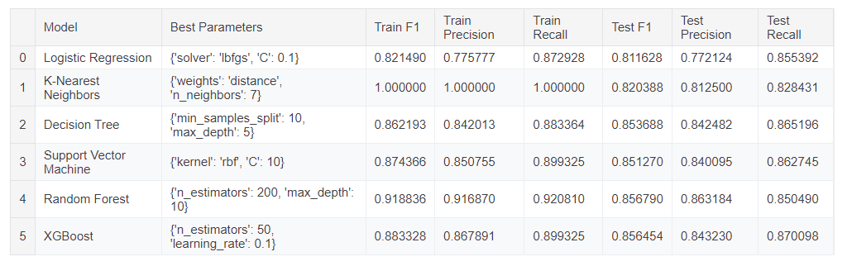
Classification Modelling : Approach (1)
Models Conclusion:
The results show that K-Nearest Neighbors (KNN) achieved perfect scores on the training set but had lower generalization performance on the test set (F1: 0.820), indicating potential overfitting. Random Forest and XGBoost performed well overall, with Random Forest having the highest training F1 (0.915) but slightly lower test F1 (0.848), while XGBoost showed balanced performance (Test F1: 0.856). Logistic Regression, Decision Tree, and Support Vector Machine (SVM) also performed well, with SVM and Decision Tree showing consistent results across both training and test sets, making them solid options. Overall, we would prefer Decision Tree as it gives almost the same results on test data and takes less time compared to Random Forest and XGB.

Slide 23
Data Preprocessing : Approach (2)
Drop unwanted columns ['id','CustomerId','Surname']
Drop Duplicates ( 2 rows found)
Handle Missing values : Filling the missing values by using Mode, Median
found 1 missing value in the following columns [‘Age’ , ‘Geography’, ‘HasCrCard’, ‘IsActiveMember’]
Converting Data Type of columns : Age : float64 → int64
Encoding Categorical features [‘Gender’,’Geography’] : One Hot Encoding
Handle Outliers using Capping method.
Handle Unbalanced Dataset : Using SMOTE
Feature Scaling : MinMaxScaler
Splitting the dataset : train (80%) , test (20%)

Slide 24
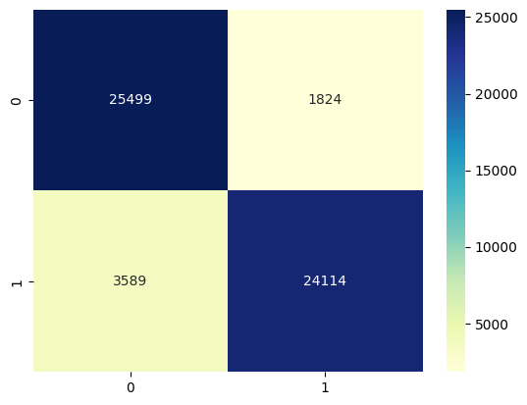

Classification Modelling : Approach (2)
XGBoost: perform Hyperparameter Tuning using “Random Search”
SDGClassifier
ML | Precision | Recall | F1-Score | Acc (Test) | Acc (Train)
XGBoost | 0.93 | 0.87 | 0.89 | 0.90 | 0.91
SDGClassifier | 0.89 | 0.82 | 0.85 | 0.85 | 0.87
XGBoost | SDGClassifier

Slide 25
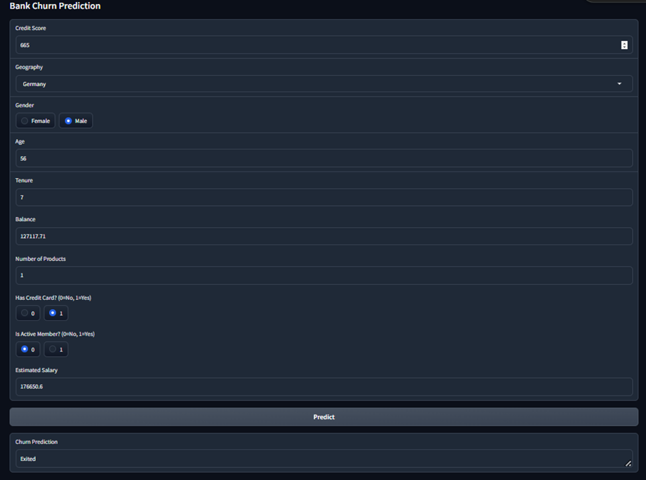
Model Deployment for approach (2): By using Gradio

Slide 26
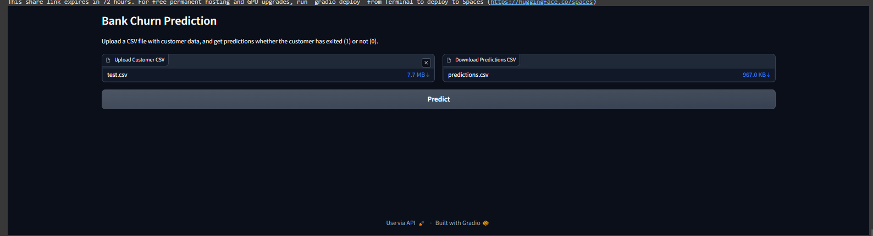
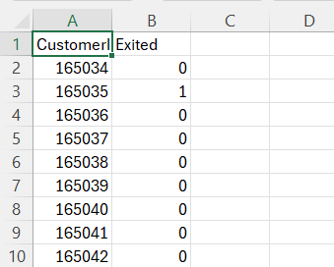
Model Deployment for approach (2): By using Gradio

Slide 27
Conclusion
This project provided valuable insights into customer churn behavior within the banking sector by thoroughly analyzing the bank customer churn dataset. Through Exploratory Data Analysis (EDA), we identified key factors influencing customer retention, such as age, balance, and product usage. Feature engineering allowed us to create meaningful features that captured deeper relationships within the data, while data preprocessing ensured that the dataset was ready for classification modeling. By evaluating various machine learning models, we were able to identify the most effective approach to predicting customer churn, with a particular focus on optimizing for class imbalance. These results can help banks develop more targeted strategies to retain high-value customers and enhance overall customer satisfaction.

Slide 28
Q&A
Questions and Answers

Slide 29
Thanks

